Slide 1
Lecture 14: Function Basics and the Function
main()
CSC111: Introduction to CS through Programming
R. Jordan Crouser
Assistant Professor of Computer Science
Smith College

Slide 2
About Assignment 3
100 / 102 assignments submitted on time (!!!)
Almost everyone included a header and had appropriate variable names (nice work)
Functionality was great! (esp. ❤️ed your creativity)
A few notes on attribution:

Slide 3
A reminder from the syllabus
Attribution:
The names of all collaborating students should be listed at the top of the submission. [Note: include help from TAs here]
If you worked alone, please state: “I did not collaborate with anyone on this assignment.”
“References”
Citations to any resources you used, including page numbers (if a printed resource) or a direct URL (if an online resource).
If you did not use any resources in completing the assignment, please state: “I did not utilize any external resources in completing this assignment.”
Approximately 74% of A3 submissions had these

Slide 4
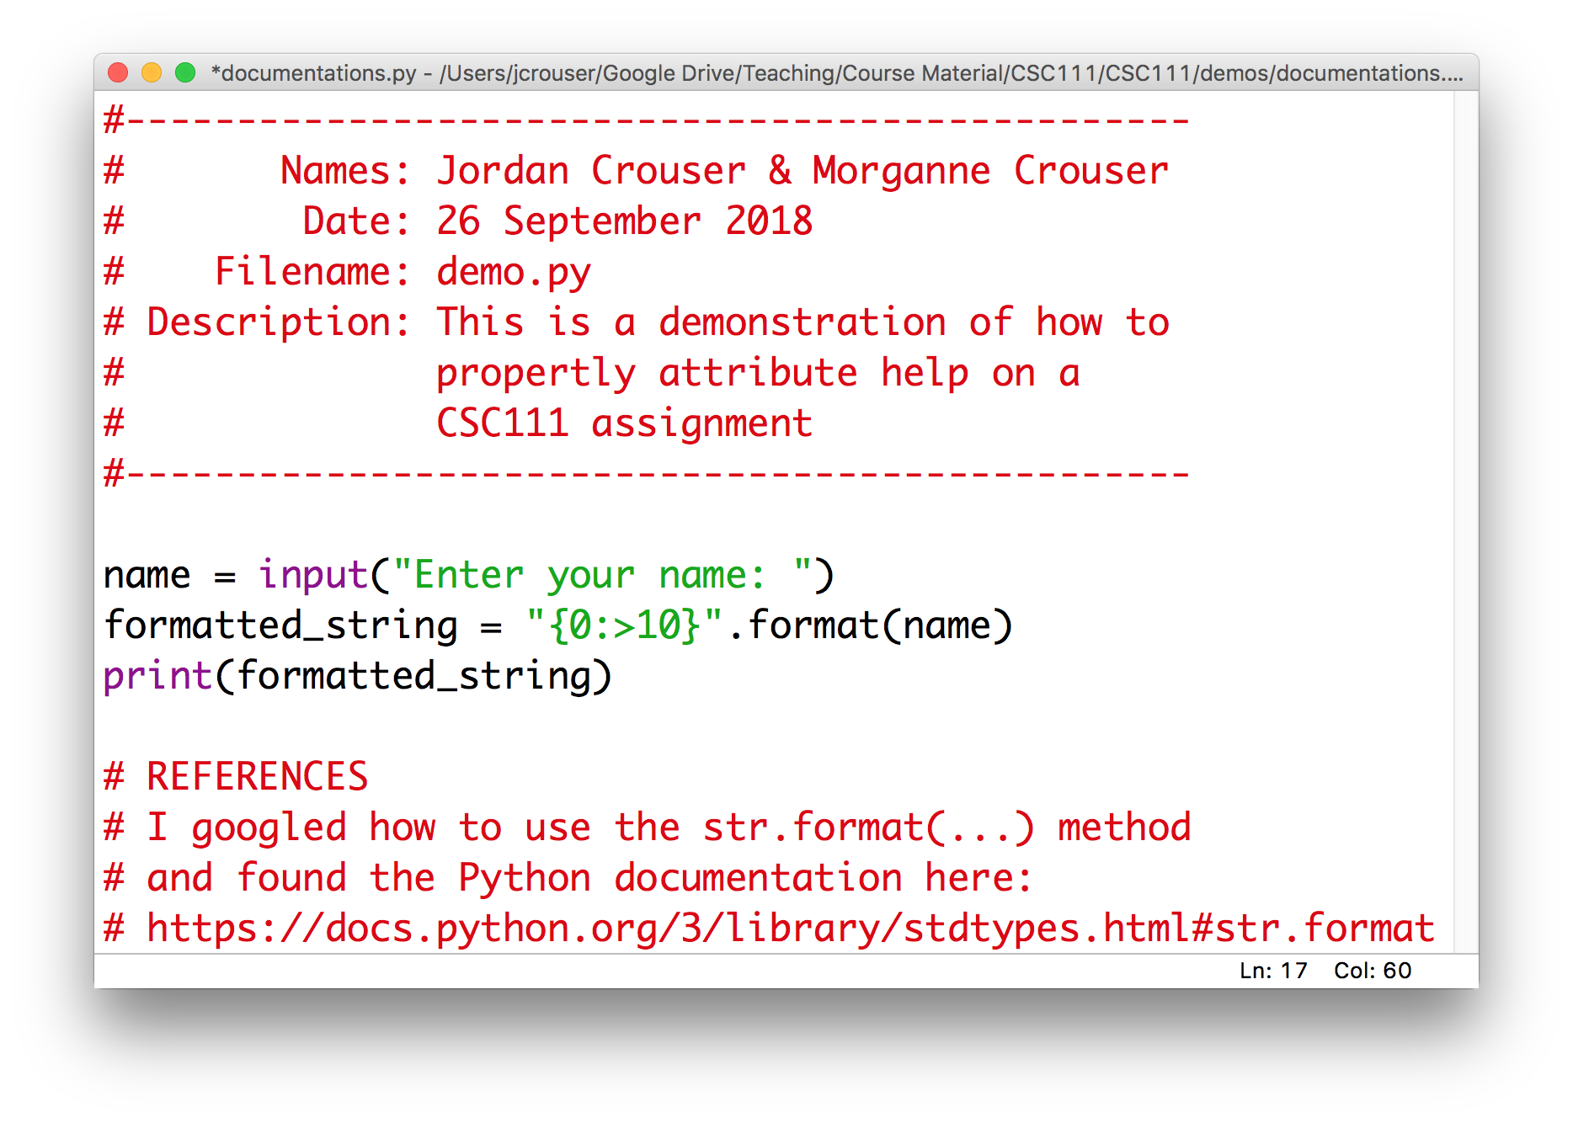
Here’s what I want to see

Slide 5
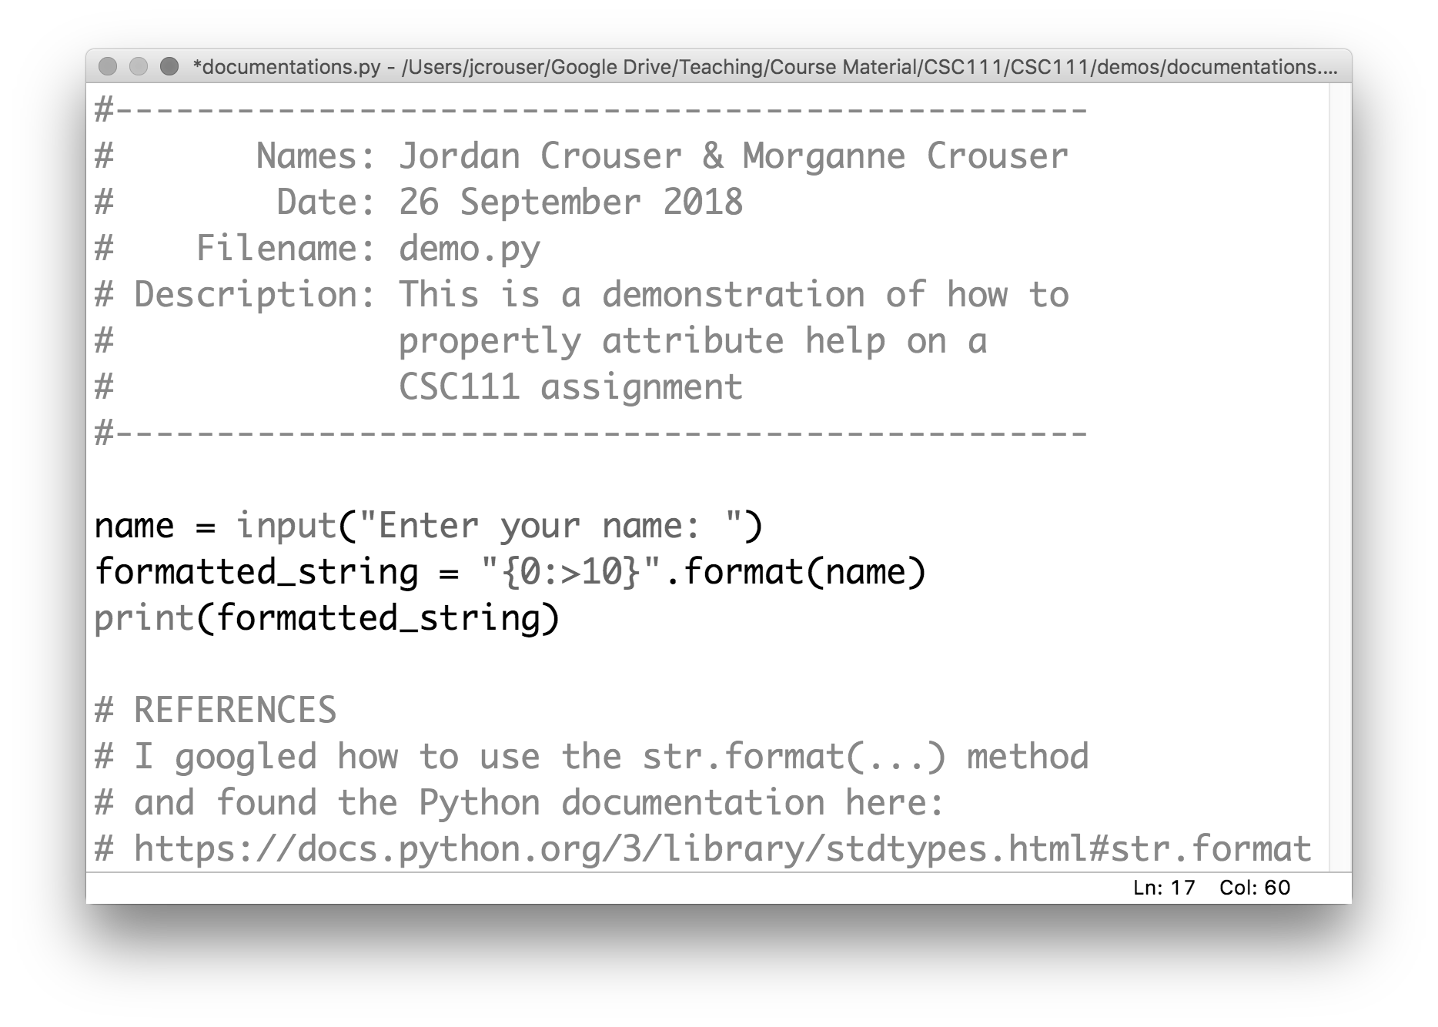
Here’s what I want to see

Slide 6
Here’s what I want to see

Slide 7
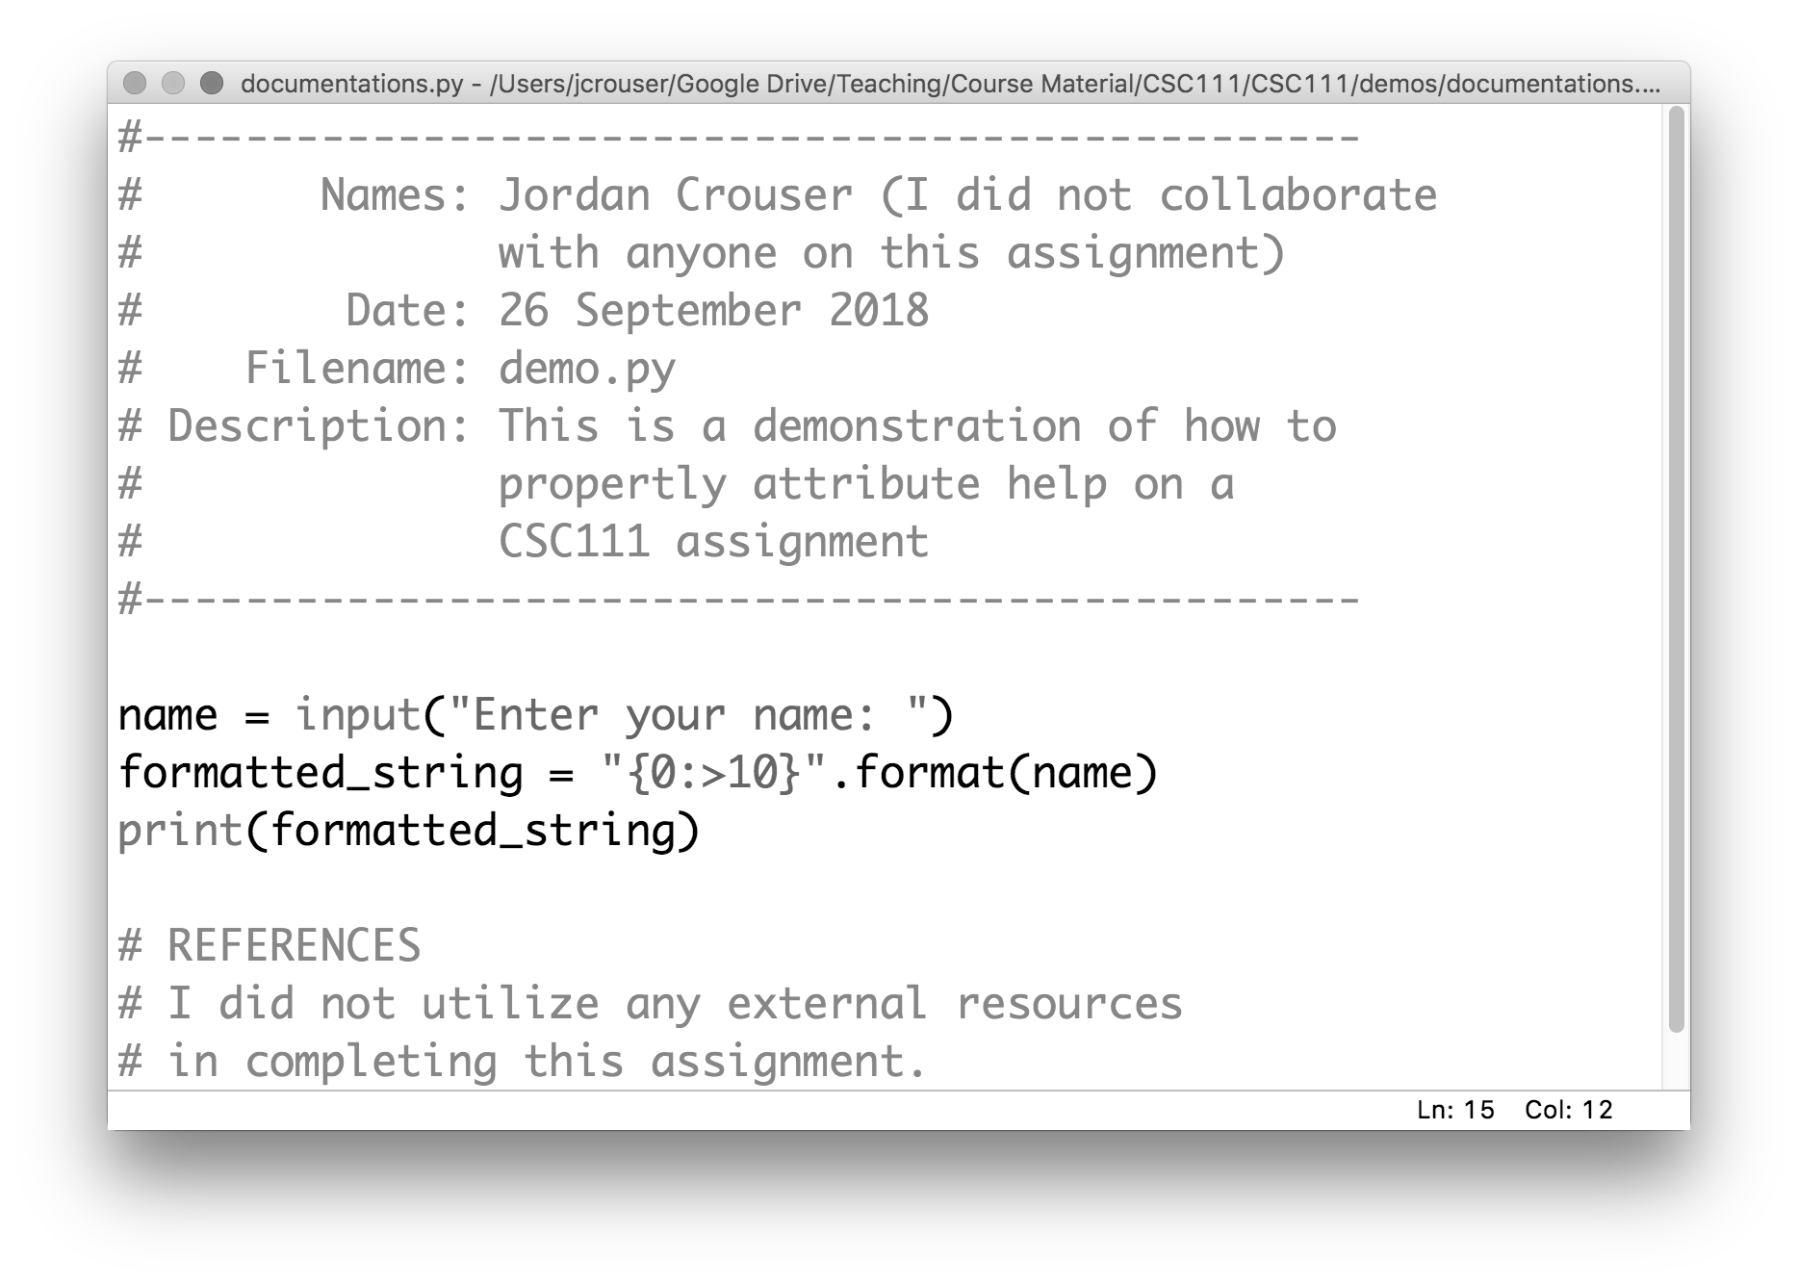
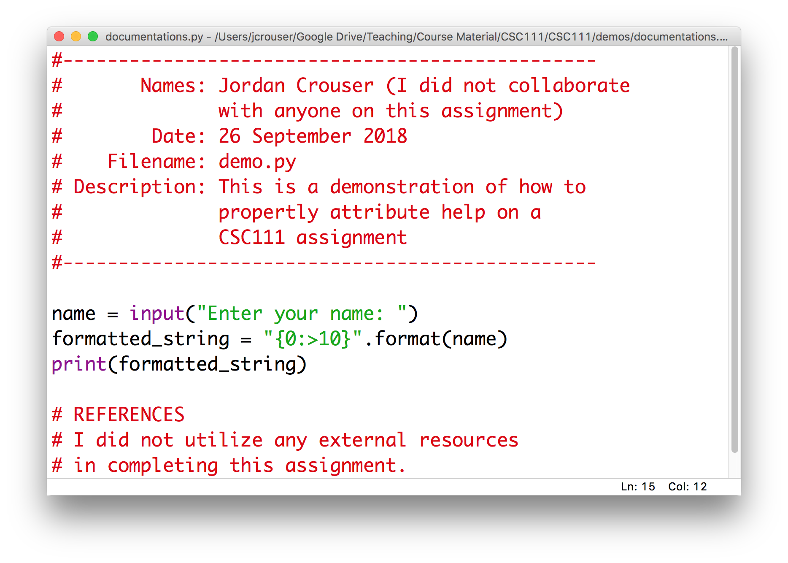
Here’s what I want to see

Slide 8
Here’s what I want to see

Slide 9
Outline
Monday: first lesson in functions
Lab: wrapping up collections (lists, dictionaries)
Wednesday: more on functions
Friday: data structures comparison

Slide 10
Functions
Recall: a function is a procedure / routine that takes in some input and does something with it (just like in math)
We’ve seen lots of built-in functions:
print(…)
input(…)
eval(…)
round(…)
Perhaps unsurprisingly, Python lets us write custom functions as well (like yesterday’s main() function)

Slide 11
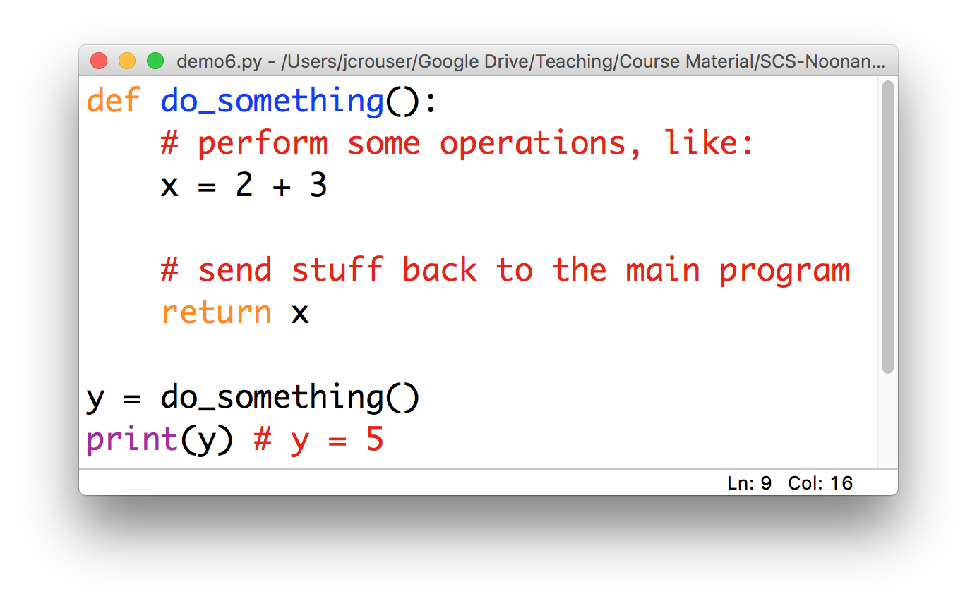
Basic components of a function

Slide 12
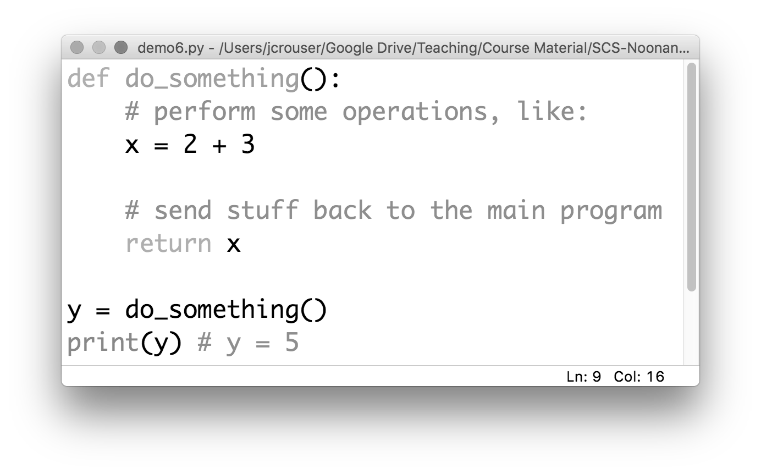
Basic components of a function
a name
Convention: use _underscores_ or camelCase

Slide 13
Basic components of a function
which is defined
using the def keyword

Slide 14
Basic components of a function
a body
(indented)

Slide 15
Basic components of a function
a return (optional)

Slide 16
A “function definition”

Slide 17

Discussion
What happens if we run this program?

Slide 18
A “function definition” is a description
(but not a directive)

Slide 19
Function calls: “hey, Python! do this”
a function call

Slide 20
Function calls: “hey, Python! do this”
5

Slide 21
An analogy
functions are your MINIONS

Slide 22
An analogy
functions have NAMES

Slide 23
An analogy
they only work when you CALL them

Slide 24
An analogy
functions
can be
called directly
stuart()

Slide 25
An analogy
functions
can also be
called by
one another
stuart()
jerry()

Slide 26
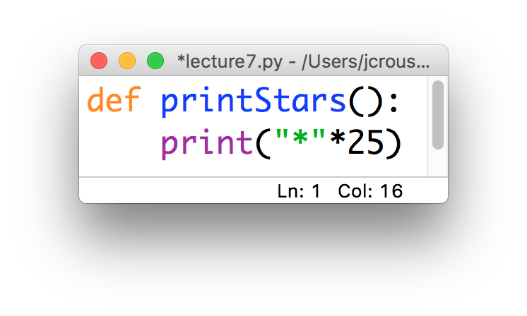
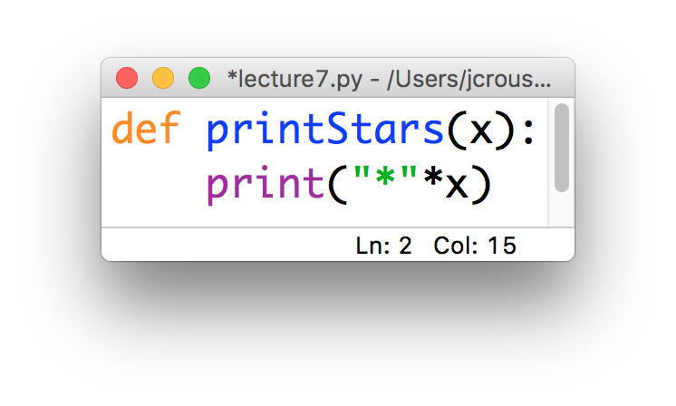
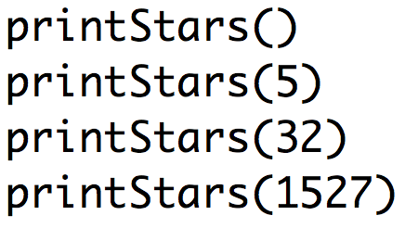
Two kinds of functions
Some functions always do the same thing
Others adjust their behavior based on what we give them
“parameter”

Slide 27
Quick demo: Happy Birthday
Write a function called happyBirthday(name) that takes in a string name and prints out the lyrics to the song ”Happy Birthday” with the name inserted:
Happy birthday to you!
Happy birthday to you!
Happy birthday, dear name
Happy birthday to you!
use input(…) to get the value of name from the user , and then call the happyBirthday(…) function to print a customized happy birthday song

Slide 28
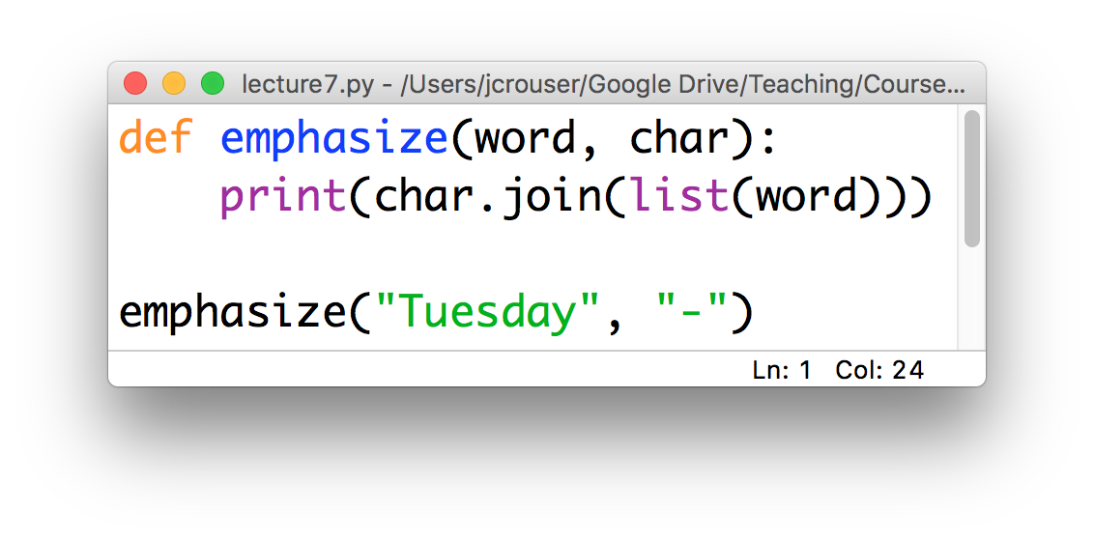
Parameters
Functions can be defined to take take several parameters:
Result:
T-u-e-s-d-a-y
char = “-”
word = “Tuesday”

Slide 29
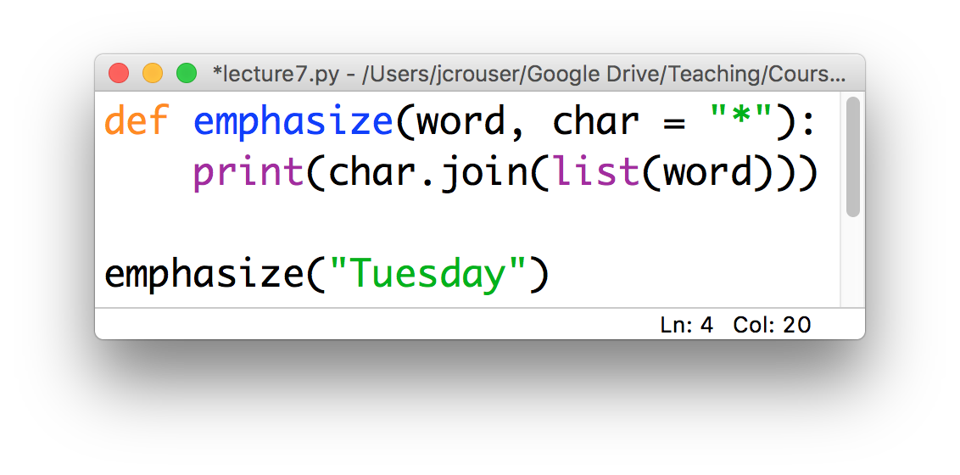
Default parameters
We can include a “default” value for some (or all) of them:
Result:
T*u*e*s*d*a*y
only one parameter

Slide 30
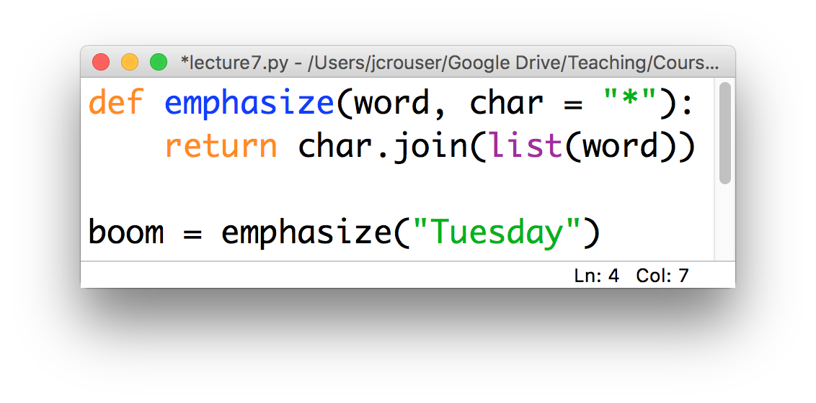
Returning values
We may want to return the results rather than print them:
the results of the return in
emphasize() are stored in boom

Slide 31
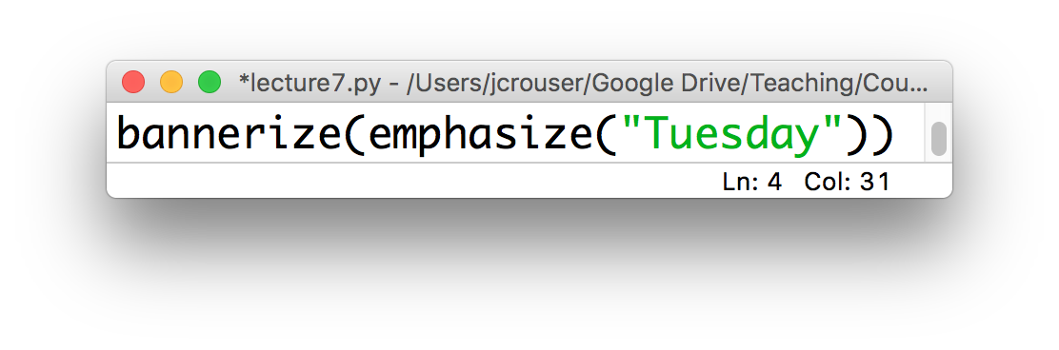
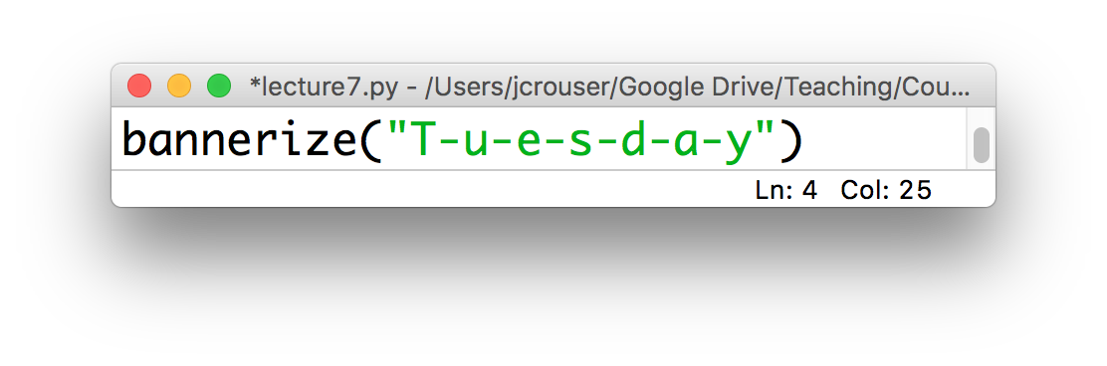
Advanced: chaining functions
Return values allow us to call functions inside other function calls:

Slide 32
Recap: functions
If you have to do something multiple times, then you probably want a function: this helps to “modularize” code (i.e. organize it for easy reuse)
Define once, call as many times as necessary
Naming convention: use camelCase
Important: one function = one task

Slide 33
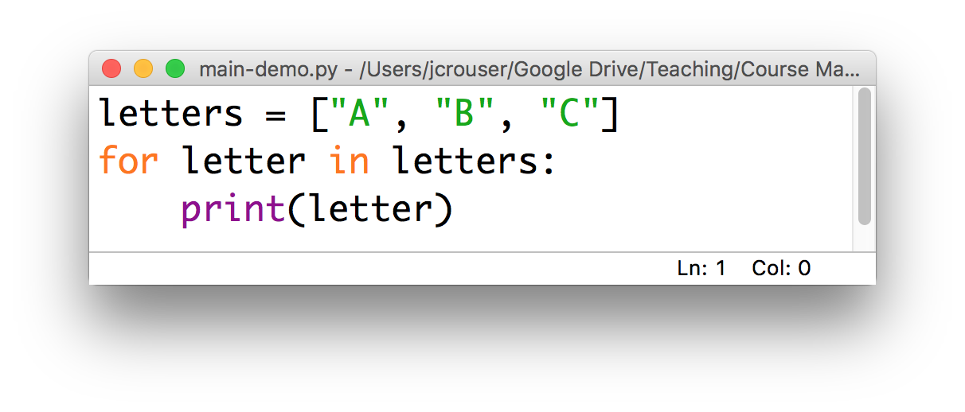
One more thing…
So far, we’ve been writing code in files as if we were writing it on the console:
When we do this, the Python interpreter executes everything from the top down

Slide 34
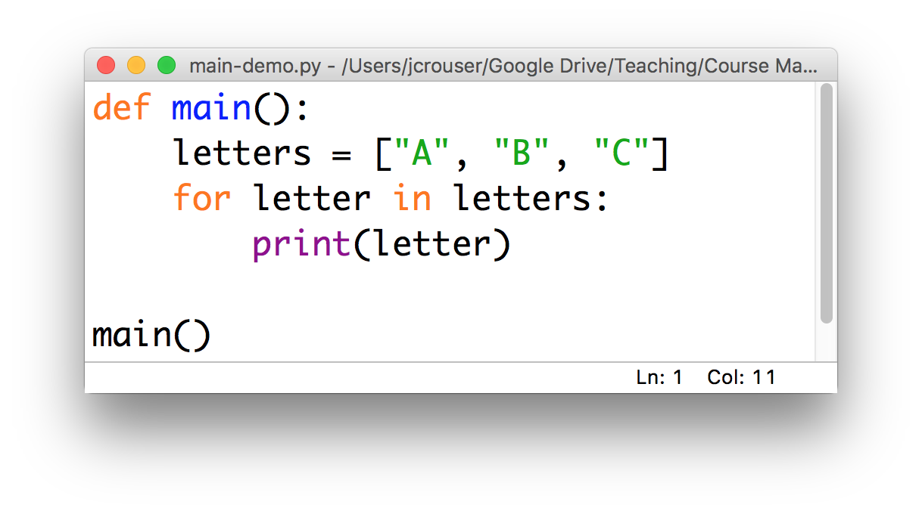
An alternative
It is better practice to write the code you want to execute inside a main() function, e.g.
This lets the interpreter ”read ahead” and then execute

Slide 35
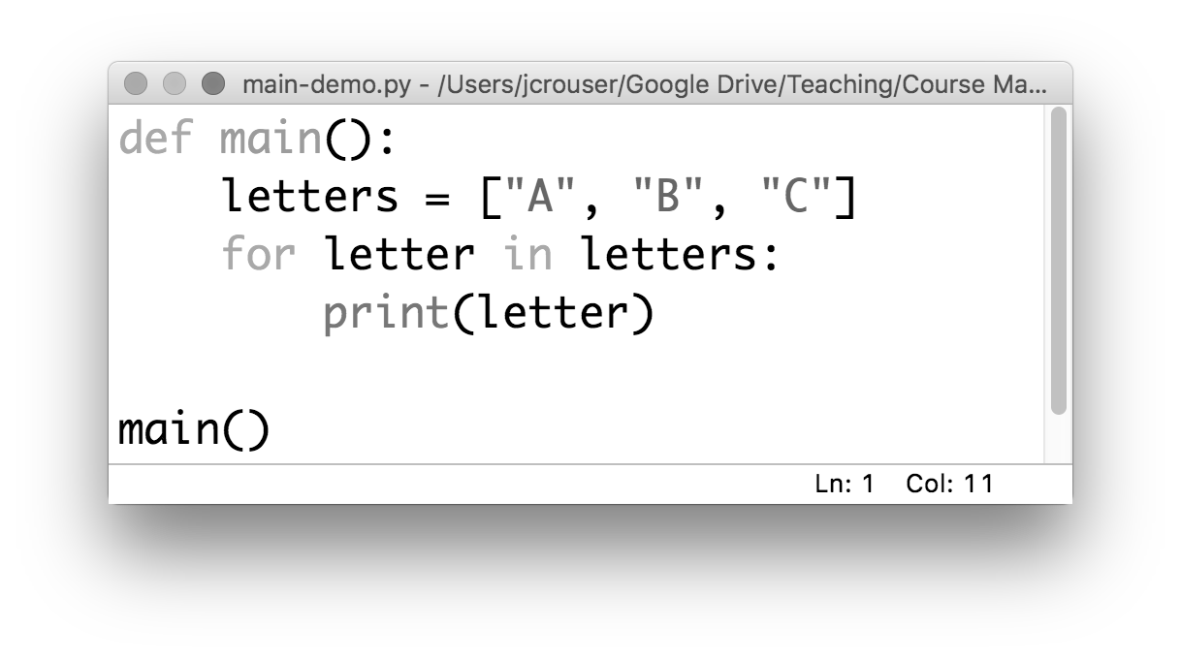
How this works
Remember: the interpreter reads from the top down, which means that it reads the definition first
Notes:
This is a lot like defining a variable (but instead of putting a value in the “box”, we’re going to fill it with code)

Slide 36
How this works
Then it reads each line inside the definition, but these don’t get executed yet

Slide 37
How this works
Then it reads each line inside the definition, but these don’t get executed yet

Slide 38
How this works
Then it reads each line inside the definition, but these don’t get executed yet

Slide 39
How this works
At this stage, we’ve given python a “recipe” for what we want it to do when we call main()
If we stop here, nothing will actually happen

Slide 40
How this works
The real work happens only when we actually call the main() function
When we do, python goes to the main() box and follows the instructions it finds there

Slide 41
Discussion
Why bother?

Slide 42
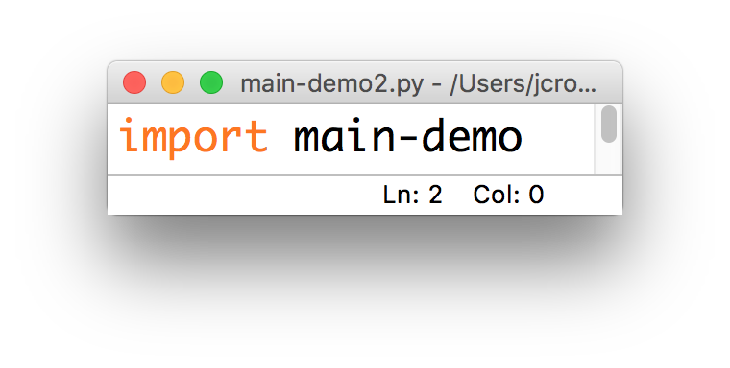
Just one more thing…
What happens if someday we want to use the code in this file as part of another program?

Slide 43
Discussion
What we need: a way to tell python to behave one way when we run it as a “stand-alone” program, and a different way when we import it
Ideas?

Slide 44
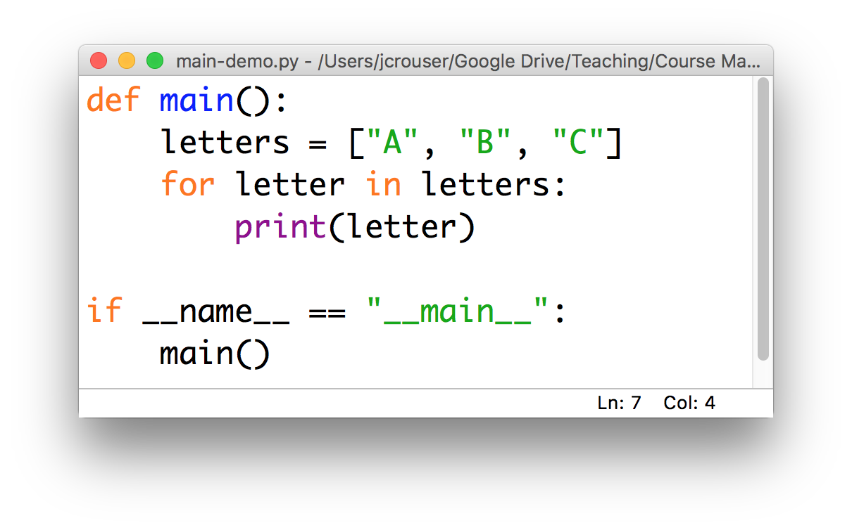
Python convention
We can use an if statement to tell python to call the main() function only if the program is being run directly

Slide 45
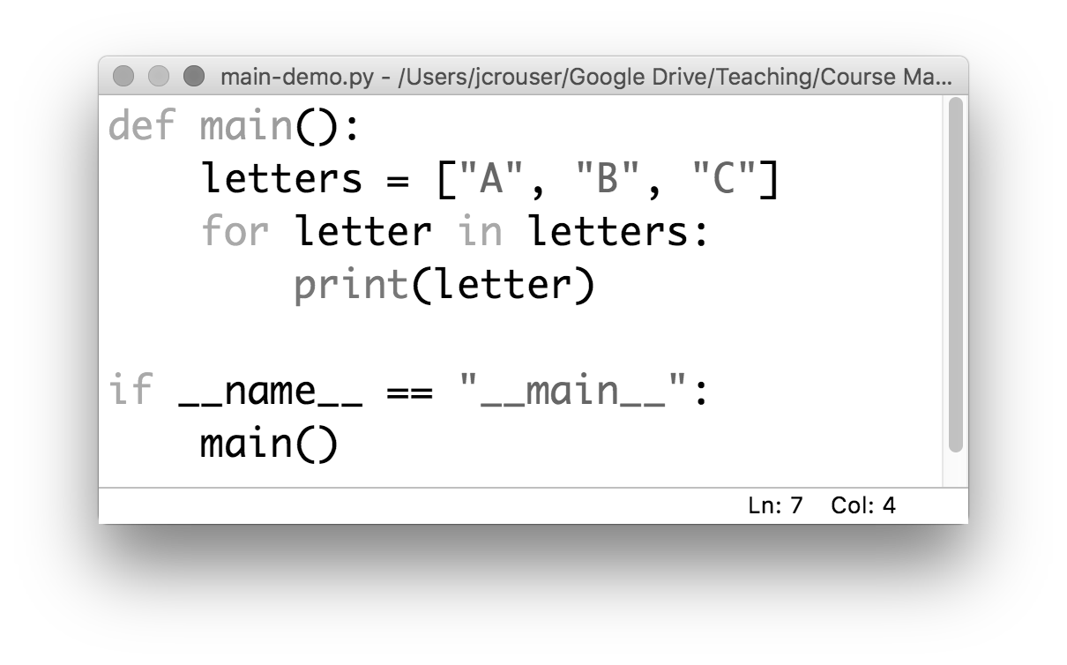
Python convention
This is a little bit confusing: we named the function we created to hold our program was called main()

Slide 46
Python convention
In our if statement, we’re asking whether some variable called __name__ is equal to the string "__main__"
(not to mention I don’t recall initializing anything called __name__...)

Slide 47
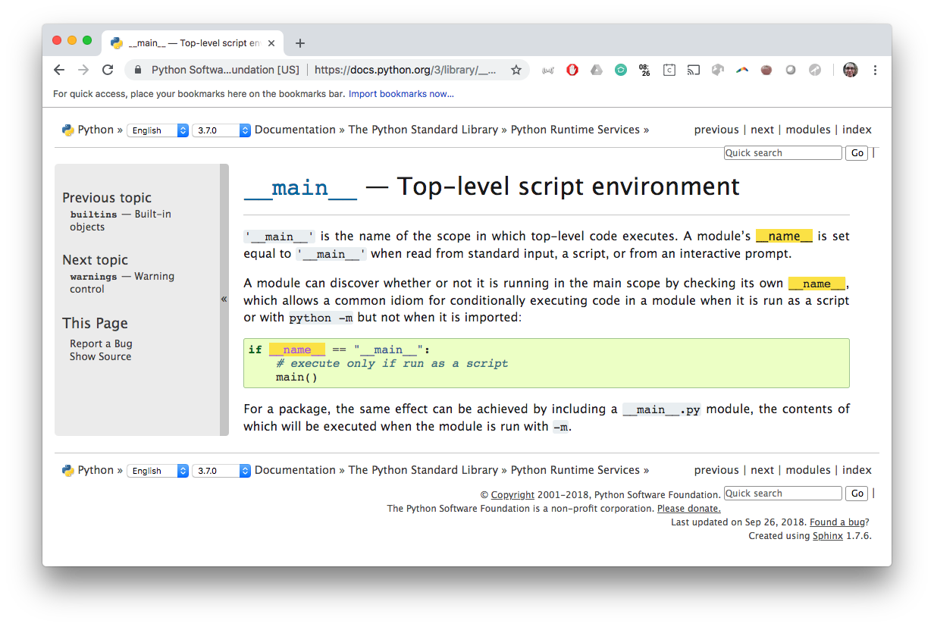
To the documentation!

Slide 48
15-minute exercise
Write a program that contains a main() function, which contains instructions for printing out the phrase:
"This program is being run directly."
Use an if statement combined with checking the value of the __name__ variable to call main() only when the program is run directly
Add an else statement so that whenever the program (“module”) is imported, it prints out the phrase:
"This program has been imported!"

Slide 49
Discussion
What did you come up with?

Slide 50
Takeaways
Programs (“modules”) that are well-organized are easier to read, more versatile, and potentially more efficient
The first step we’ll take toward organizing our code is to include a main() function, which includes the instructions we want our program to run
To make it easier to import code we write now into later modules, we will follow the convention of including:
if __name__ == "__main__":
main()
at the end of each module

Slide 51
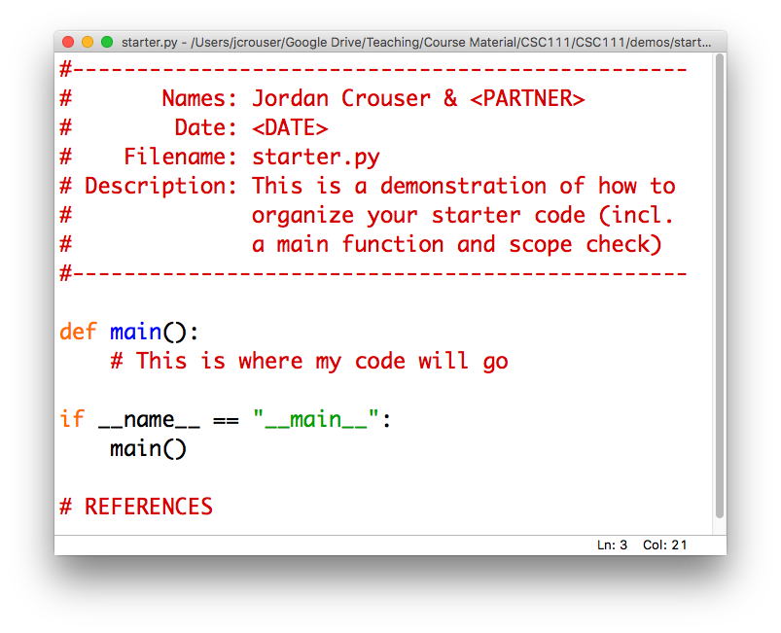
Helpful tip: have a starter template

Slide 52
Takeaways
What’s one thing you learned
in today’s class?

Slide 53
Outline
Monday: first lesson in functions
Lab: wrapping up collections (lists, dictionaries)
Wednesday: more on functions
Friday: data structures comparison

